Slide 1
Cancer Biology Biol 445
Spring 2020
Dr. Heidi Super
Lecture 31
4-24-2020

Slide 2
Announcements
Quiz 5 –One week. April 27th.
Topics list today
BB meeting---optional. To ask questions.
Sunday 7-7:30 pm (longer if students need more time). https://us.bbcollab.com/guest/03638ea9e41c4c4a8229d33c435609a0

Slide 3
Where were we?
Most of what we’ve been talking about has focused on using immune system molecules or mechanisms to block signal transduction leading to accelerated proliferation, or to enhance killing of tumor cells
or helping the cancer patients own immune system target cancer cells.

Slide 4
Adoptive cell transfer
TILs surrounding a person’s tumor can be grown and selected for best ability to attack tumor cells in vitro.
Then the most potent of these cells can be infused back into the patient-–with the hope that they will return to the tumor and kill many cells. Fig 11-16

Slide 5
Chimeric Antigen Receptor (CAR) CAR T-cells
The T-cell then expresses a TCR that is part antibody antigen receptor site and part TCR.
It also included sequences that make the TCR function efficiently on it’s own without needing some of the other molecules on the T-cell surface.

Slide 8
Early use of CAR T-cells had SERIOUS side effects. The administration of so many T-cells elicited an out of control immune response called a “Cytokine storm”.
Nearly killed first recipients. Now these responses are closely monitored and better controlled.

Slide 9
The pathogenicity of viruses like COVID-19 and the 1918/Spanish influenza pandemic is largely due to the hosts overblown immune response---due to massive release of cytokines---the cytokine storm.

Slide 10
Therapeutic vaccines
Cancer Treatment Vaccines--
Some work has been done testing “vaccination” for patients who have cancer and who have had conventional treatments (surgery, radiation, chemotherapy).
The idea is to prevent relapse/reemergence of cells which are resistant/refractory to those conventional treatments.

Slide 11
Methods?
Use of whole tumor cells---rendered incapable of dividing, but which potentially show all tumor antigens to the immune system
Use of specific identified tumor antigens (whole proteins or fragments) from the patient’s tumor

Slide 12
Recall this?....

Slide 13
Autologous vaccine---the cells used to vaccinate are from that patient)
Allogeneic vaccine---cells from another individual showing most relevant tumor antigens.
Drug Canvaxin---whole cell vaccine consisting of 3 melanoma cell lines.

Slide 15
Most therapeutic vaccines are available only in clinical trials. (Bladder, brain, breast, cervical, prostate, colorectal, kidney, leukemia, lung, melanoma)
One approved for metastatic prostate cancer that is resistant to hormone therapy.
Called sipulencel-T (Provenge)

Slide 16
Modest efficacy…

Slide 17
APC-based vaccines
Antigen presenting cells are responsible for activating T-cells (which can potentially recognize and kill cancer cells)
APCs can be artificially forced to take up and present tumor antigens (in vitro) and then given back to a patient.
In theory the patient has increased his/her chances of T-cells “seeing” the tumor antigen

Slide 18
The most important type of APC is called a dendritic cell. Dendritic cell vaccines have shown efficacy in several types of cancer.

Slide 19
Adjuvants
Often vaccines are given in combination with agents that give a general boost to immune responses.
The adjuvant tricks the immune system into thinking there is a major pathogen invasion, and many immunostimulatory signals are triggered.
Some bacterial toxins are good adjuvants. Human stress proteins have also shown promise as adjuvants.

Slide 20
Prophylactic/preventative cancer vaccines
Thus far, preventative vaccines have not really been approved---why might that be?
Approved cancer vaccines---any vaccine for a pathogen strongly associated with cancer.
HPV vaccine
HBV vaccine

Slide 21
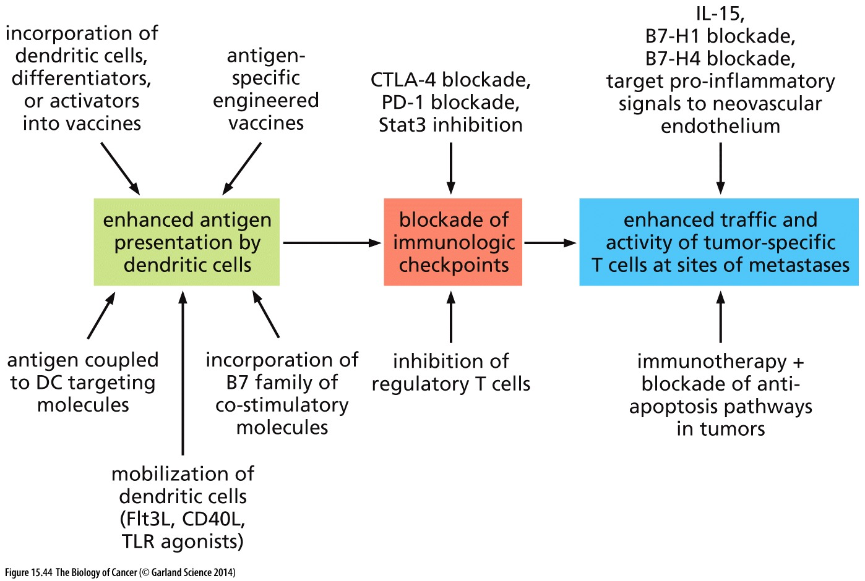
Immune system manipulations

Slide 22
Becoming an approved cancer treatment
Before we move on…I realize we haven’t formerly discussed the actual process of a clinical trial.
Clinical trials may be approved if enough in vitro and animal model evidence suggests the agent may work in humans…
From lab bench to bedside….

Slide 23
Clinical trials
Long-term
Multiple discipline teams
Patient participants!
Physicians
Medical support—tests/imaging/health management
Data collection
Analysis

Slide 24
Careful regulation
Information---many professionals involved in explaining purpose, methods, expected outcomes, risks.
Informed consent
Institutional review for human subjects
IRB approval

Slide 25
It is essential to have evidence that the new drug/procedure is actually better than the current best practice, in some way.
Clinical trials must procure funding.
Government (NCI)
Pharmaceutical companies
Non-profit organizations
*In the US, the Affordable Care Act mandates that insurance companies pay for normal patient care while under a clinical trial.

Slide 26
Phase 0/I
Safety of the drug/procedure
Research on safe doses—highest dose with no serious side effects
Dose timing and delivery
Observations of side effects
Testing for changes in effect of other drugs you may be taking. Some monitoring of efficacy
Small number of volunteers (phase 0)…then more (20-80). Several months-1year

Slide 27
Phase II (~70% of phase I move on)
Continued monitoring of safety
Focus on Efficacy
Fine-tuning of dosage
Comparison to standard treatment(s) of the day

Slide 28
Phase III (~30% move on from phase II)
True comparison of new drug/procedure to standard treatments. Must be as safe and effective as standard treatment to move forward with the drug.
Requires careful controls—randomization of patients receiving the drug and those receiving the standard
Thousands of participants if possible—more rare side effects show up.

Slide 29
Most Phase III trials are double-blind, meaning the participants and the clinicians and researchers don’t know which participants are receiving the new and standard drugs
No one should have expectations or bias in phase III.

Slide 30
Phase II and III groups/arms
Participants may receive several types of treatments---so there can be several arms to a Phase III trial.
Experimental arm---getting new drug
Active comparison arm—getting old drug
Placebo comparison arm—getting inert/inactive compound—no drug activity
Sham/mock comparison arm---getting similar overall care/drug but contains no active form of experimental drug
No intervention arm

Slide 31
Phase IV—post approval (25-30% of phase III—those that receive approval for general use of the new drug/procedure)
Continued monitoring/comparison of the new drug.
Gain info on long-term safety and effectiveness
Begin to note resistance, if it occurs
May note off–target benefits of a drug

Slide 32
With increased education and control over one’s own treatment, more people know about and seek out clinical trials.
https://clinicaltrials.gov/ct2/home

Slide 33
Gleevec!
One of the all time fastest drugs to go from to bench to bedside.
~2.5 years after the compound was synthesized and chemically shown to bind to the BCR-ABL fusion protein. (Applied for its use as a drug)
Approved after 3 phase II trials showed nearly 90% cure rate for CML in 2.5 months. Placebo arm particiapnts were placed immediately into the experimental drug arm!

Slide 34
Next time…
We will discuss the rational design of the drug Gleevec.

